Slide 1
Team Overhead
Grace C, Sireesha D, Rehaan K, Pranathi R, Aadi S, Arham S, Ashar S, Nohami Z
Team Overhead
Notes:
Pranathi

Slide 2
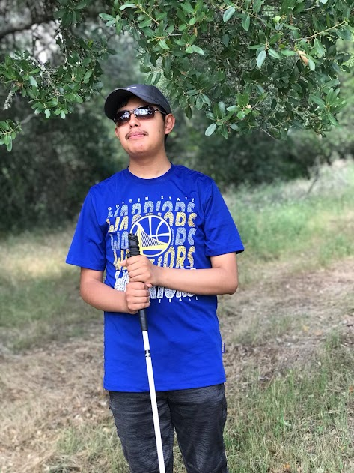
Community Partner
Meet Omar!
Notes:
Pranathi
Omar is a visually impaired 18-year old. A young man in this rapidly developing society, Omar lost his eyesight at the mere age of 15. He is currently residing at the Hatlen Center, where he learns to be more independent by taking classes that teach their visually impaired students how to navigate technology, manage their finances, and more.

Slide 3
The Problem
Notes:
Problem
According to the CDC…
Over one million people in the U.S. were blind as of 2015. Over three million people in the U.S. had a visual impairment. By 2050, the numbers are projected to double.
Because of these predicted numbers, something has to be done to address the problems that come with visual impairment or blindness. For Omar specifically, when he’s outside, he typically uses a cane to navigate. However, his cane is unable to detect overhead objects, such as branches and street signs. Omar has indicated that this is one of the most pressing issues he tackles on a daily basis. He often has to walk with his hand above his head in order to shield himself from these objects, as the injuries that could occur because of them could have an exceedingly detrimental impact to him. In addition, his height only worsens the problem, as it increases the risk of him colliding with overhead objects.

Slide 4
Quotes
“I . . . have to know when I’m walking, obviously you guys know there are branches sticking out of trees, signs above eye level, that obviously my cane is not going to feel, because the cane is on the ground. “
“Sometimes we [the visually impaired] use our hand, but we might not know that something is there, so that is something else we sometimes have to deal with…”
Notes:
Pranathi
When meeting with Omar via zoom, we got to fully understand his struggles in his day-to-day life. Some notable statements of his included…

Slide 5
Considered Solutions
Product | Explanation
Overhead Movement Alarm Radar (Hat) | Practical Portable Hard to integrate certain components in the hat
Built-In GPS or Voice Assistant Attachment | Portable User-friendly Not time-friendly Bulky
Maneuvering Device (Clip-On to Cane) | User-friendly/easy-to-use Easy-to-build Portable Can fall off/get lost easily Not as efficient
Notes:
Pranathi
OMAR: Pros- Easy to build, Time-friendly, Practical, Portable, Cons- Hard to integrate certain components in the hat
Built-In GPS or Voice Assistant w/ Cane: Pros- Helpful, Portable, User-friendly, Cons- Not time-friendly, Bulky
Maneuvering Device (Clip-On to Cane): Pros- User-friendly/easy-to-use, Easy-to-build, Portable, Cons- Can fall off/get lost easily, Not as efficient

Slide 6
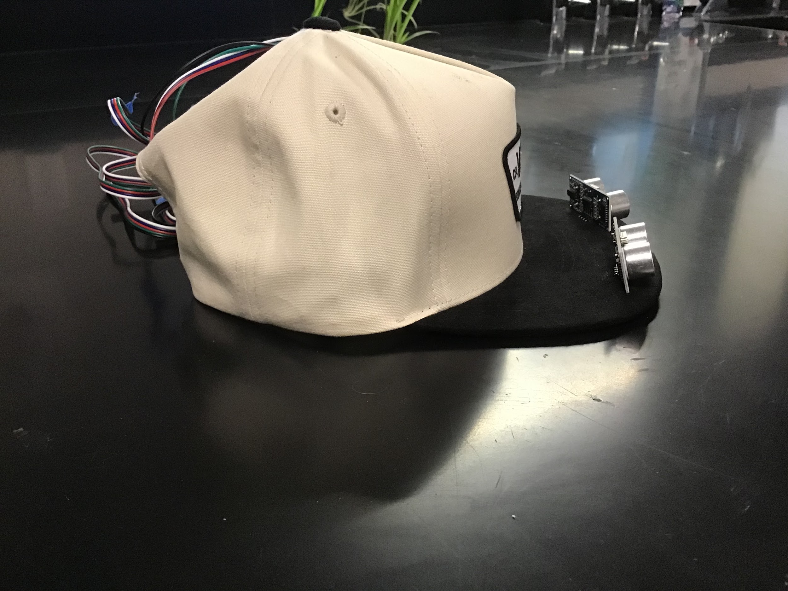
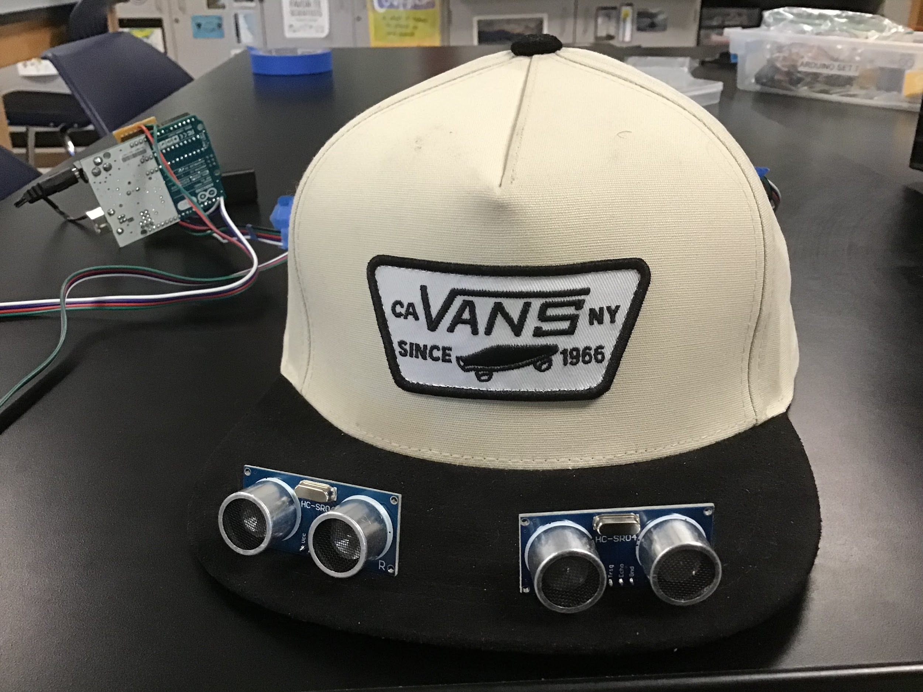
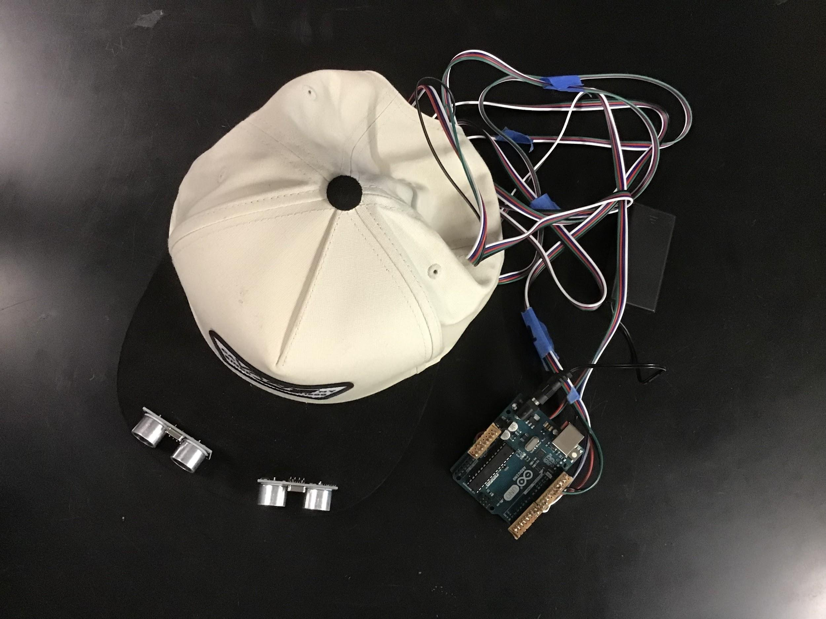

Solution
The OMAR is a hat that can detect overhead objects that a cane cannot, in order to minimize collisions.
Notes:
Nohami
The OMAR stands for overhead movement alarm radar. When an obstacle is detected 3 feet away from the user, the user will feel vibrations at their temples, signaling them about the obstacle. The vibrations will become more noticeable as the user gets closer to the object. From this information, the user will be able to get an accurate sense of where the object is based on the frequency of the vibrations. Our device is powered by a 9 volt battery pack. On the right, you can see images of our product and here is a video of how our device works.

Slide 7
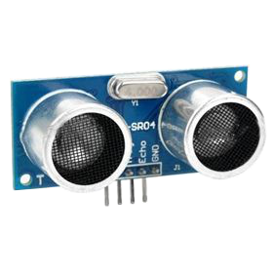
Ultrasonic Sensors
Notes:
Nohami
One of our most important components of this device are the ultrasonic sensors. Ultrasonic sensors measure the distance between the sensor and the object ahead of it. There are two ultrasonic sensors attached to the brim of the hat to detect overhead objects within a 3 feet radius.

Slide 8
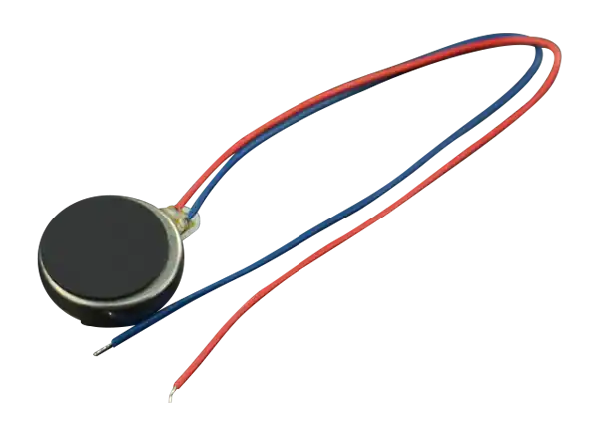
Vibration Motors
Notes:
Nohami
We also have two vibration motors sewed into the seams of the cap near the user’s temples. They will vibrate based on the location of the object relative to the user. For instance, the motor on the left will vibrate if the object is on the left of the user.

Slide 9
Feedback from Omar
“...so far, it sounds good…that actually would really work obviously in my case since I’m living by my own and I walk around sometimes…that actually would be really good.”
Notes:
Nohami
After completing a prototype of our design, we relayed our developments to Omar via Zoom. One notable statement of his was…

Slide 10
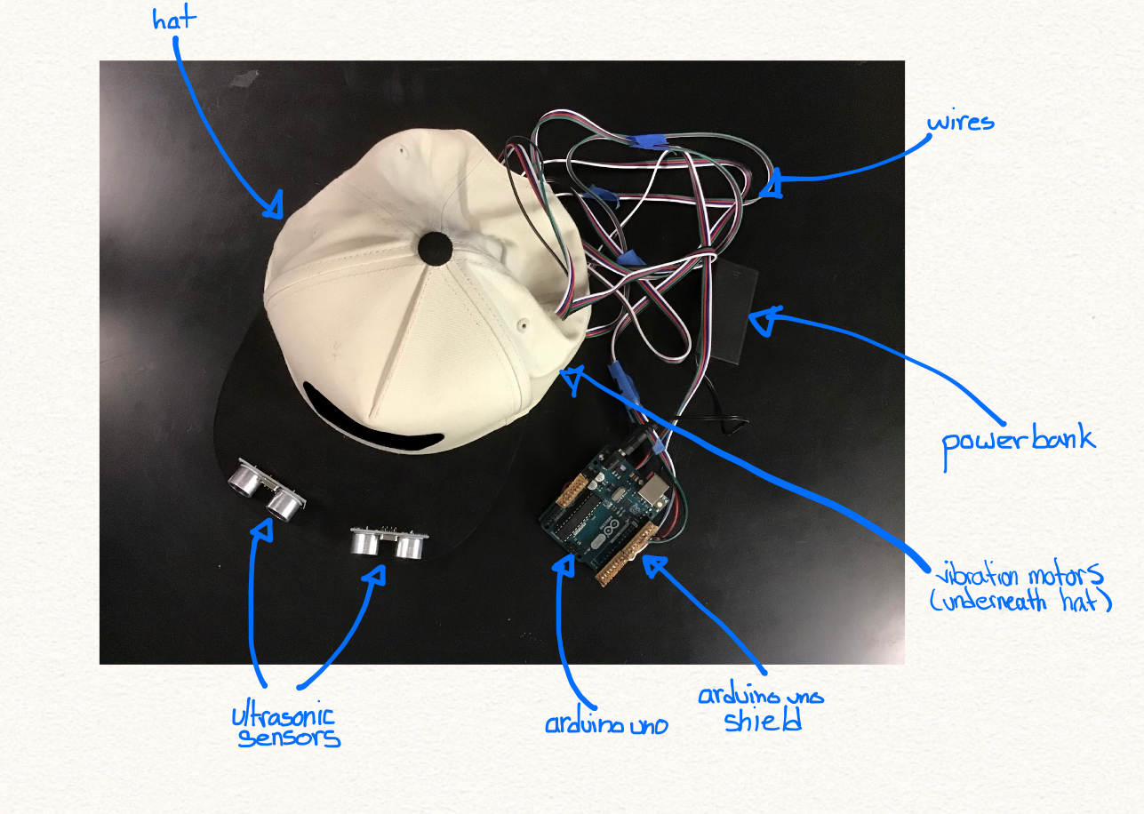
Diagram
Notes:
Nohami
As you can see all of the components of our hat are labeled. The ultrasonic sensors, arduino uno, 9 volt power bank, wires, hat, and vibration motors are all visible in this image.

Slide 11
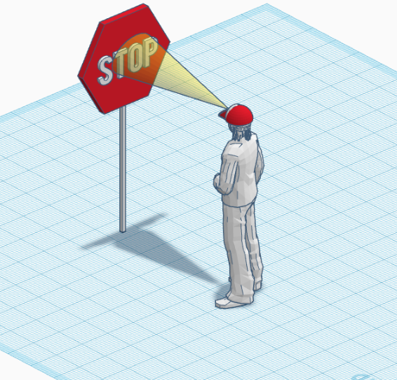
How Would It Work?
Notes:
Nohami
So, how exactly does it work? When the user comes within 3 feet of an overhead object, the ultrasonic sensors detect it and notify the vibration motors. The vibration motors will then begin vibrating near the user's temple, alerting the user to the presence of an object ahead of them. Depending on which side is vibrating, the user will take a step to the opposite side until no vibrations are felt.

Slide 12
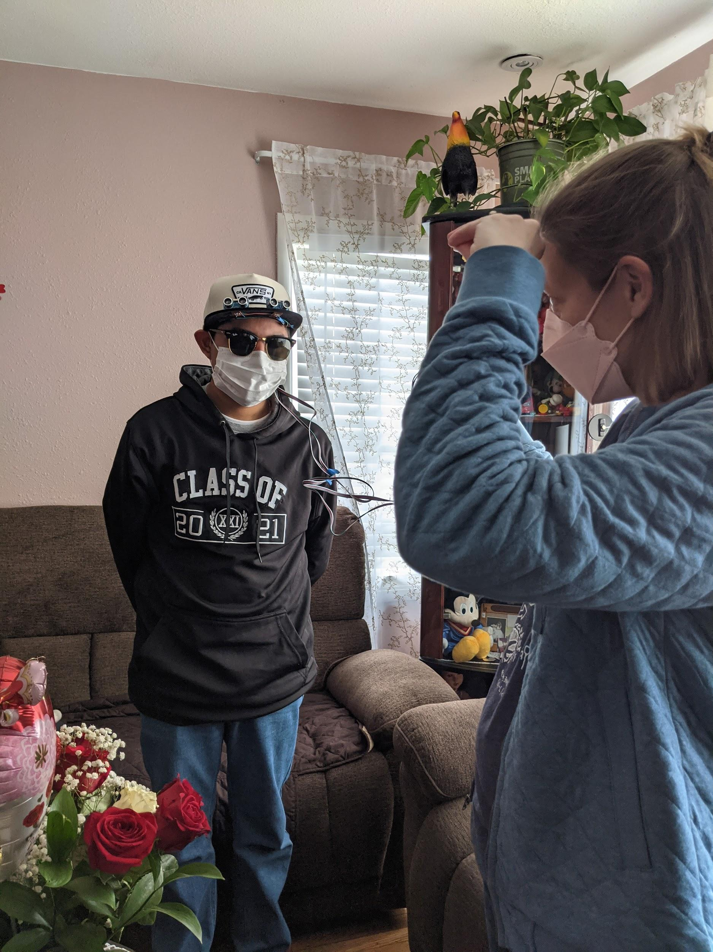
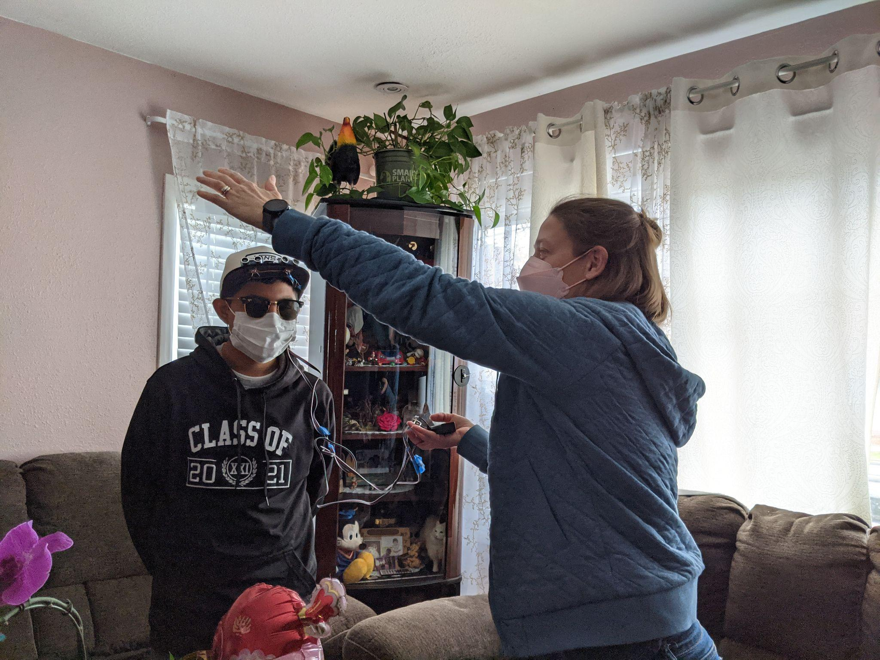
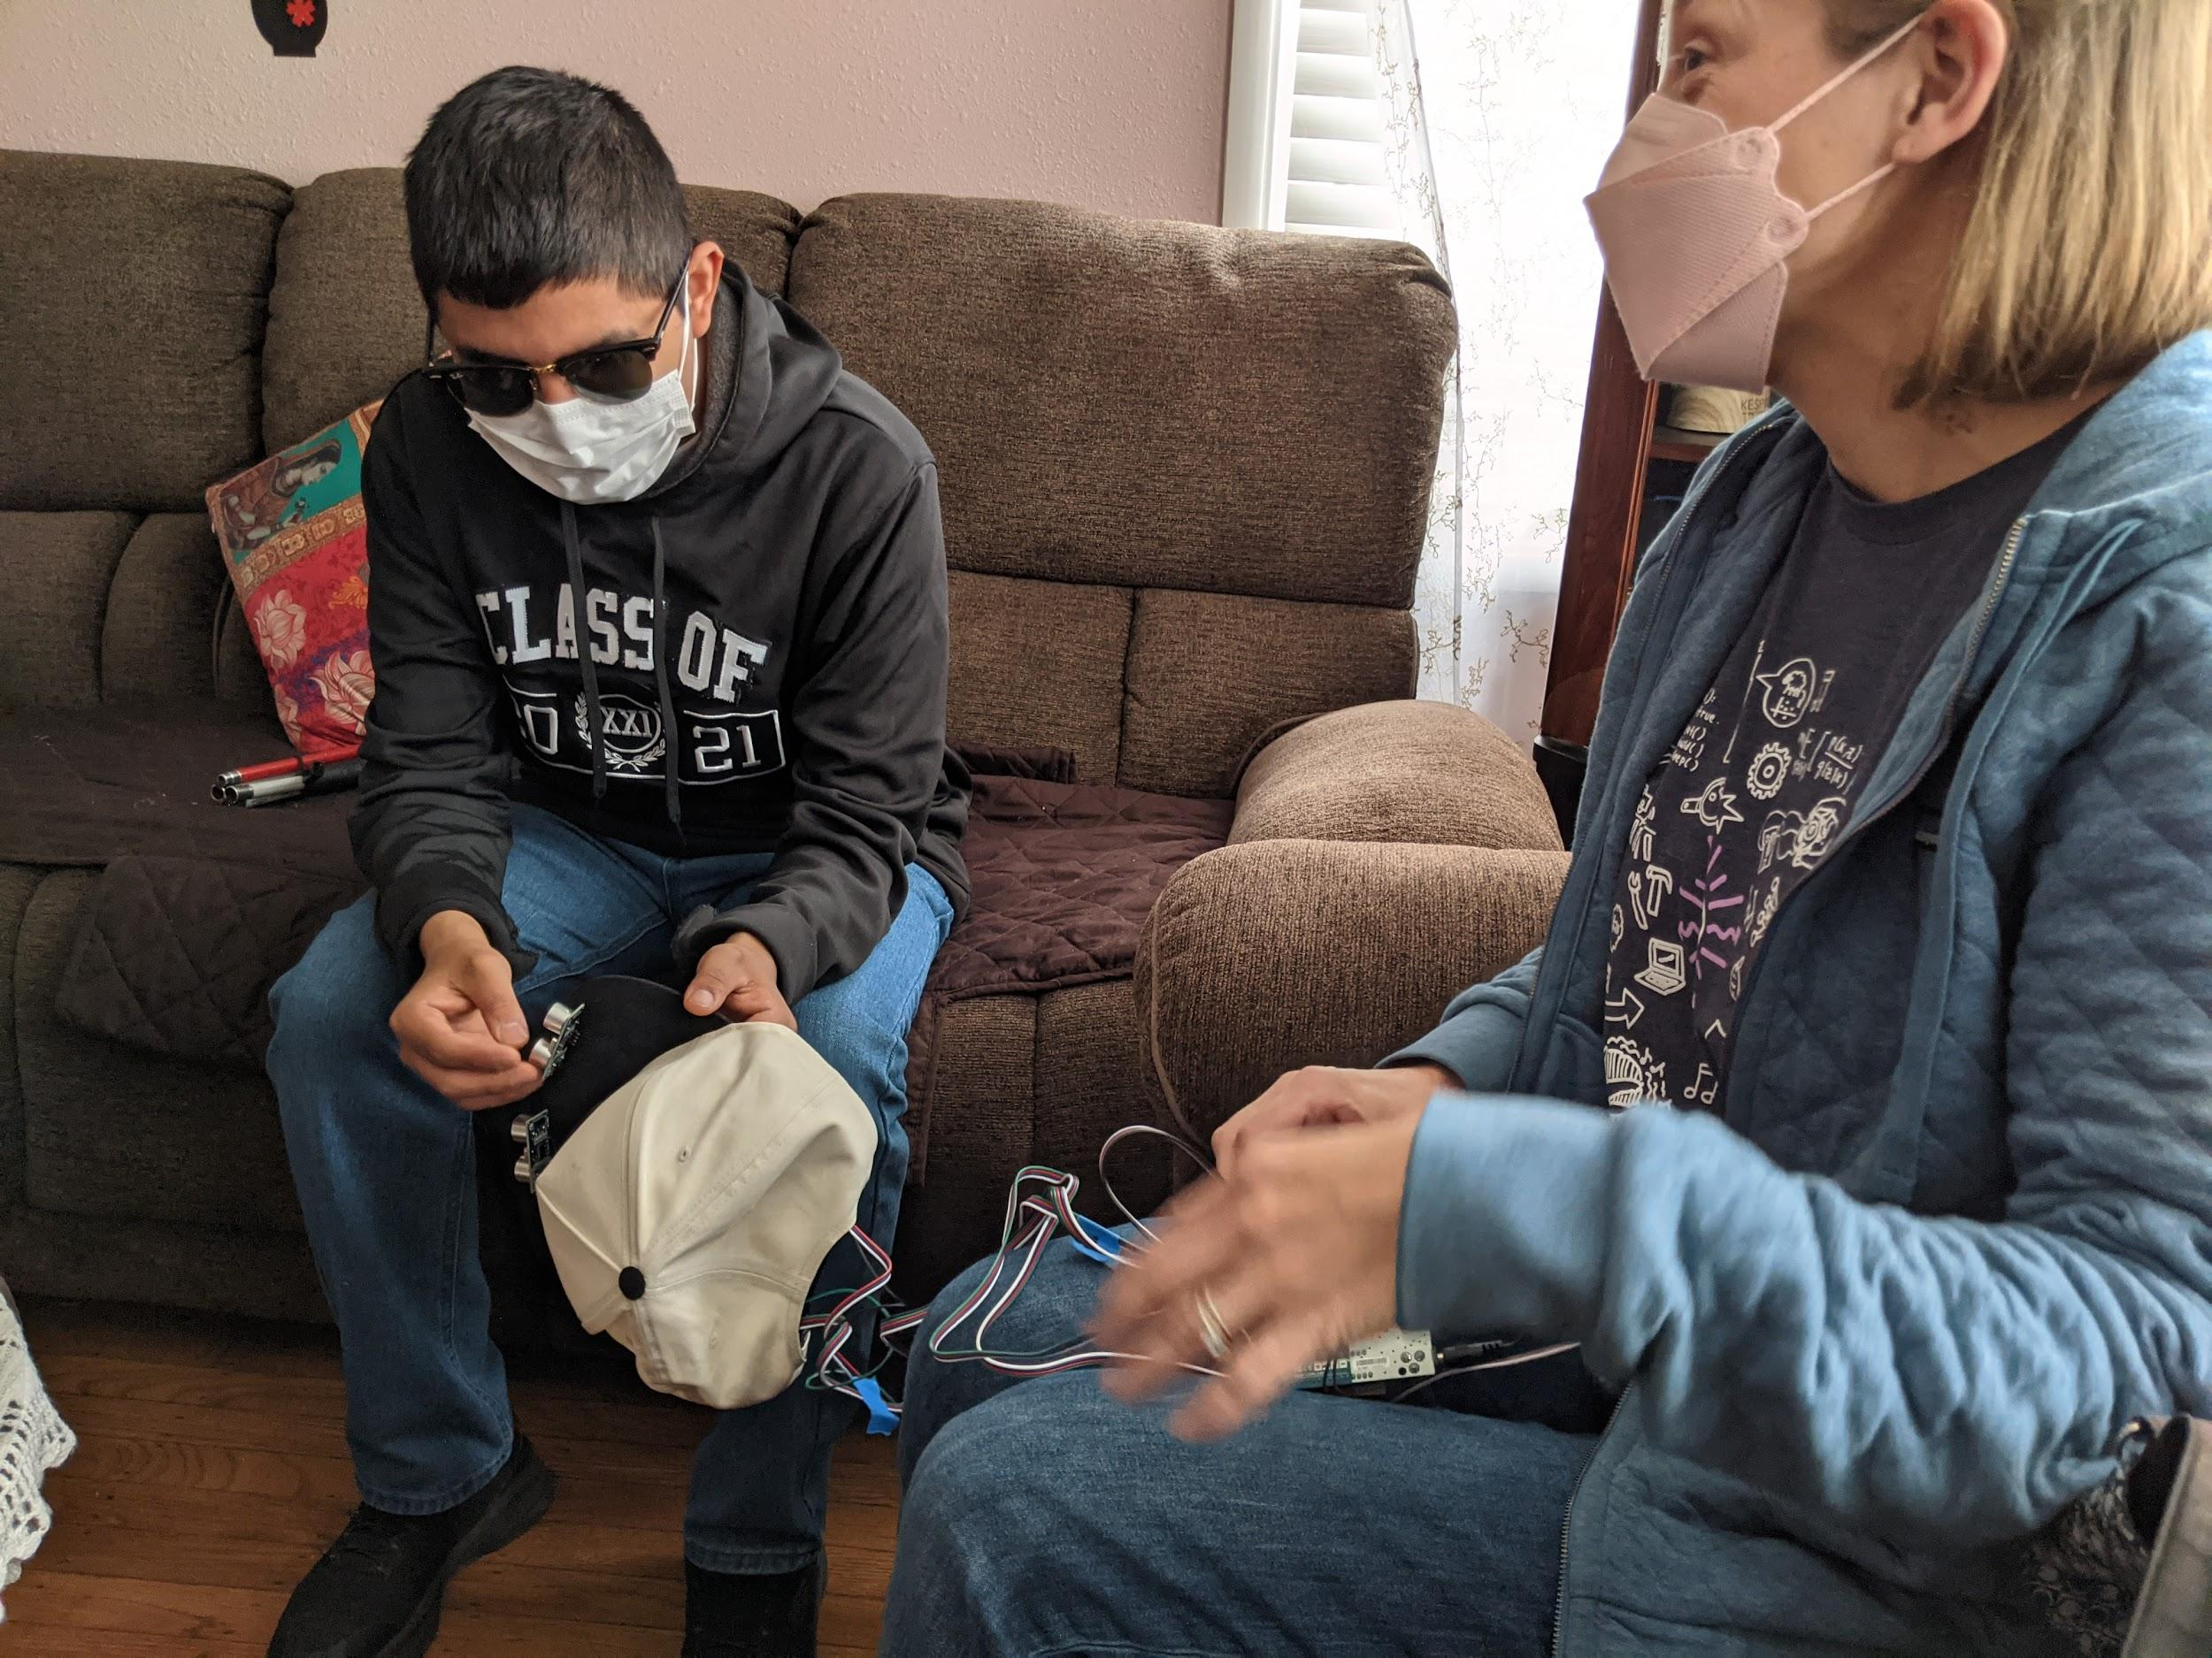
User Testing
Notes:
Ashar
In order to test our prototype, our teachers drove down to meet Omar. The prototype worked fairly well and Omar seemed enthusiastic about getting it working even better. The amount of vibrating seemed good and it was able to differentiate left from right. Something Omar’s father mentioned was that vehicle side mirrors can be particularly hazardous. As a result, he felt that the prototype served its purpose for Omar.

Slide 13
Testing Feedback From Our Teacher
“The prototype worked fairly well and Omar seemed enthusiastic about getting it working even better. His parents and sister were there too and…they also seemed excited…”
Notes:
Ashar
After our testing was done, our teacher mentioned this about the tests, “ “.

Slide 14
Competitor Matrix
Product | Durable | Lightweight | Compact | Hands-free | Diverse User Compatibility | Cost
The OMAR | ✓ | ✓ | ✓ | ✓ | ✓ | $75 USD
WeWalk Cane | ✓ | ✓ | ✓ |  |  | $599 USD
UltraCane | ✓ | ✓ | ✓ |  |  | $803 USD
iGlasses |  | ✓ |  | ✓ | ✓ | $143.95 USD
Product | Durable | Lightweight | Compact | Hands-free | Diverse User Compatibility | Cost
The OMAR | ✓ | ✓ | ✓ | ✓ | ✓ | $75 USD
WeWalk Cane | ✓ | ✓ | ✓ |  |  | $599 USD
UltraCane | ✓ | ✓ | ✓ |  |  | $803 USD
iGlasses |  | ✓ |  | ✓ | ✓ | $143.95 USD
Product | Durable | Lightweight | Compact | Hands-free | Diverse User Compatibility | Cost
The OMAR | ✓ | ✓ | ✓ | ✓ | ✓ | $75 USD
WeWalk Cane | ✓ | ✓ | ✓ |  |  | $599 USD
UltraCane | ✓ | ✓ | ✓ |  |  | $803 USD
iGlasses |  | ✓ | ✓ | ✓ | ✓ | $143.95 USD
Notes:
Ashar
All of these products are similar to the product we have now, as they all aid those who are visually impared and have trouble detecting objects that are at their eye level. They all use different ways to notify their user but they do share some common qualities such as portability. Although they have similar qualities and features, their costs are vastly different. WeWalk Cane:
Really solid (no rattle sound)
Voice Assistant, Google Maps, and other features
Ultra Cane:
bulky, yet compact
Sends off tactile feedback through vibration
I-Glasses:
are lightweight and compact, yet easily broken
It’s also on the pricier side.
It is important to note that existing products are not cost efficient and they rely more on the user’s ability to interpret and process sound, while our product uses feeling to alert the user

Slide 15
Next Steps
First
Second
Third
Fine tune the angle and range
Make components more compact and hide the wiring
Add water protection to sensors
Notes:
Although we currently have a working model of our prototype, we still have a lot to improve upon.
For one, we would like to continue fine tuning the angle and range that the sensors provide to the user. Furthermore, we still have to make the controller more compact so that it weighs less and takes up less space in the hat, and hide the wiring that is still visible. In addition to the controller and wiring, we also need to make the ultrasonic sensors resistant to nature, which could be done by adding enclosures for the sensors mounted on the hat..

Slide 16
THANK YOU!
Notes:
Ashar

